Slide 1
Algorithm Design & Analysis
Name: Anam Khan

Slide 2
CONTENT
Introduction.
Sorting Problem
Insertion Sort
Example
Running Time
Analysis
Asymptotic Performance
Conclusion

Slide 3
Design and Analysis of Algorithms
Analysis: predict the cost of an algorithm in terms of resources and performance
Design: design algorithms which minimize the cost
Algorithm: a process or set of rules to be followed in calculations or other problem-solving operations, especially by a computer.

Slide 4
The problem of sorting
Input: sequence áa₁, a₂, …, a_{n}ñ of numbers.
Output: permutation áa'₁, a'₂, …, a'_{n}ñ such
that a'₁ £ a'₂ £ … £ a'_{n} .
Example:
Input: 8 2 4 9 3 6
Output: 2 3 4 6 8 9

Slide 5
Insertion sort
INSERTION-SORT (A, n) ⊳ A[1 . . n]
for j ← 2 to n
do key ← A[ j]
i ← j – 1
while i > 0 and A[i] > key
do A[i+1] ← A[i]
i ← i – 1
A[i+1] = key
“pseudocode”
1
i
j
n
A:
key
sorted

Slide 6
Example of insertion sort
8
2
4
9
3
6
8
2
4
9
3
6
2
8
4
9
3
6
L1.<number>

Slide 7
Example of insertion sort
8
2
4
9
3
6
2
8
4
9
3
6
2
4
8
9
3
6
2
4
8
9
3
6
L1.<number>

Slide 8
Example of insertion sort
8
2
4
9
3
6
2
8
4
9
3
6
2
4
8
9
3
6
2
4
8
9
3
6
L1.<number>

Slide 9
Example of insertion sort
8
2
4
9
3
6
2
8
4
9
3
6
2
4
8
9
3
6
2
4
8
9
3
6
L1.<number>

Slide 10
Example of insertion sort
8
2
4
9
3
6
2
8
4
9
3
6
2
4
8
9
3
6
2
4
8
9
3
6
2
3
4
8
9
6
L1.<number>

Slide 11
Example of insertion sort
8
2
4
9
3
6
2
8
4
9
3
6
2
4
8
9
3
6
2
4
8
9
3
6
2
3
4
8
9
6
L1.<number>

Slide 12
Example of insertion sort
8
2
4
9
3
6
2
8
4
9
3
6
2
4
8
9
3
6
2
4
8
9
3
6
2
3
4
8
9
6
2
3
4
6
8
9
done
L1.<number>

Slide 13
Running time
The running time depends on the input: an already sorted sequence is easier to sort.
Major Simplifying Convention: Parameterize the running time by the size of the input, since short sequences are easier to sort than long ones.
  T_{A}(n) = time of A on length n inputs
Generally, we seek upper bounds on the running time, to have a guarantee of performance.
L1.<number>

Slide 14
Kinds of analyses
Worst-case: (usually)
  T(n) = maximum time of algorithm on any input of size n.
Average-case: (sometimes)
  T(n) = expected time of algorithm over all inputs of size n.
  Need assumption of statistical distribution of inputs.
Best-case: (NEVER)
  Cheat with a slow algorithm that works fast on some input.
L1.<number>

Slide 15
Machine-independent time
What is insertion sort’s worst-case time?
BIG IDEAS:
Ignore machine dependent constants,
otherwise impossible to verify and to compare algorithms
Look at growth of T(n) as n → ∞ .
“Asymptotic Analysis”
L1.<number>

Slide 16
Asymptotic Performance
When n gets large enough, a Q(n²) algorithm always beats a Q(n³) algorithm.
.Asymptotic analysis is a useful tool to help to structure our thinking toward better algorithm
We shouldn’t ignore asymptotically slower algorithms, however.
Real-world design situations often call for a careful balancing
T(n)
n
n₀
L1.<number>

Slide 17
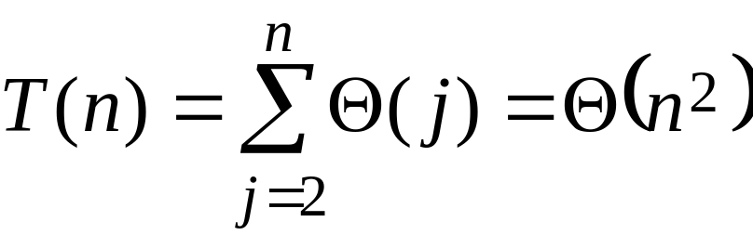
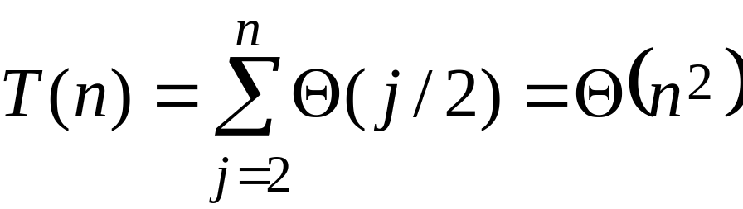
Insertion sort analysis
Worst case: Input reverse sorted.
[arithmetic series]
Average case: All permutations equally likely.
Is insertion sort a fast sorting algorithm?
Moderately so, for small n.
Not at all, for large n.
L1.<number>

Slide 18
Conclusions
Q(n lg n) grows more slowly than Q(n²).
Therefore, merge sort asymptotically beats insertion sort in the worst case.
In practice, merge sort beats insertion sort for n > 30 or so.
L1.<number>

